Slide 1

DIVINE GRACE COLLEGE OF ARTS, SCIENCE AND TECHNOLOGY
(DGCAST) — GAROUA | GEOGRAPHY DEPARTMENT
UPPER SIXTH ARTS — ECONOMIC GEOGRAPHY — PRACTICAL WORK 3
Material Index, Location Triangles and Isodapanes
Mr KAMDEM EMMANUEL
Geography Teacher — PLEG
Academic Year 2026 / 2027
Notes:
Good morning, class. Today we study Practical Work 3: Material Index, Location Triangles and Isodapanes.

Slide 2
GEOGRAPHY — UPPER SIXTH ARTS
CLASS INFO
Class, Chapter & Duration
Class | Upper Sixth Arts
Chapter | Module 6: Understanding and managing the dynamics of economic activities across the world in general and Cameroon in particular
Duration | 2 periods (2 × 50 minutes)
2026 / 2027
DGCAST GAROUA — GEOGRAPHY DEPARTMENT
Mr KAMDEM E. | 2

Slide 3
GEOGRAPHY — UPPER SIXTH ARTS
IDENTIFICATION
Lesson Identification
Topic | Theories of Industrial Location
Sub-topic | Theories of Industrial Location
Lesson | Practical Work 3: Material Index, Location Triangles and Isodapanes
Notions / Concepts | Material index, location triangle, ton-kilometres, isodapane, critical isodapane.
Syllabus focus | Calculation of material index and location types; location triangles; plotting and interpreting isodapanes and least labour cost location.
Competence | Learners are able to calculate the material index and use isodapanes.
2026 / 2027
DGCAST GAROUA — GEOGRAPHY DEPARTMENT
Mr KAMDEM E. | 3

Slide 4
GEOGRAPHY — UPPER SIXTH ARTS
OBJECTIVES
Learning Objectives
By the end of the lesson, the learner should be able to:
Calculate the material index.
Find the least transport cost point in a triangle.
Interpret isodapanes for a labour location.
2026 / 2027
DGCAST GAROUA — GEOGRAPHY DEPARTMENT
Mr KAMDEM E. | 4

Slide 5
GEOGRAPHY — UPPER SIXTH ARTS
RECALL
Recall
MI = materials ÷ product.
Isodapanes join equal extra transport costs.
2026 / 2027
DGCAST GAROUA — GEOGRAPHY DEPARTMENT
Mr KAMDEM E. | 5

Slide 6
GEOGRAPHY — UPPER SIXTH ARTS
REAL-LIFE SITUATION
Real-Life Situation
An investor wants to build a cement factory. It needs 1.6 t of limestone and 0.2 t of gypsum for each tonne of cement. The class must advise where to build.
2026 / 2027
DGCAST GAROUA — GEOGRAPHY DEPARTMENT
Mr KAMDEM E. | 6
Notes:
Read the situation slowly, twice.

Slide 7
GEOGRAPHY — UPPER SIXTH ARTS
REAL-LIFE SITUATION
Situation — Question 1
What is the problem in the situation?
2026 / 2027
DGCAST GAROUA — GEOGRAPHY DEPARTMENT
Mr KAMDEM E. | 7

Slide 8
GEOGRAPHY — UPPER SIXTH ARTS
REAL-LIFE SITUATION
Answer
The class must find the best factory location.
2026 / 2027
DGCAST GAROUA — GEOGRAPHY DEPARTMENT
Mr KAMDEM E. | 8

Slide 9
GEOGRAPHY — UPPER SIXTH ARTS
REAL-LIFE SITUATION
Situation — Question 2
What must they calculate first?
2026 / 2027
DGCAST GAROUA — GEOGRAPHY DEPARTMENT
Mr KAMDEM E. | 9

Slide 10
GEOGRAPHY — UPPER SIXTH ARTS
REAL-LIFE SITUATION
Answer
The material index.
2026 / 2027
DGCAST GAROUA — GEOGRAPHY DEPARTMENT
Mr KAMDEM E. | 10

Slide 11
GEOGRAPHY — UPPER SIXTH ARTS
REAL-LIFE SITUATION
Situation — Question 3
What is MI here?
2026 / 2027
DGCAST GAROUA — GEOGRAPHY DEPARTMENT
Mr KAMDEM E. | 11

Slide 12
GEOGRAPHY — UPPER SIXTH ARTS
REAL-LIFE SITUATION
Possible Answer
(1.6 + 0.2) ÷ 1 = 1.8, so near the limestone.
2026 / 2027
DGCAST GAROUA — GEOGRAPHY DEPARTMENT
Mr KAMDEM E. | 12

Slide 13
GEOGRAPHY — UPPER SIXTH ARTS
JUSTIFICATION
Justification of the Lesson
This practical work helps us to apply Weber's model with numbers.
2026 / 2027
DGCAST GAROUA — GEOGRAPHY DEPARTMENT
Mr KAMDEM E. | 13

Slide 14
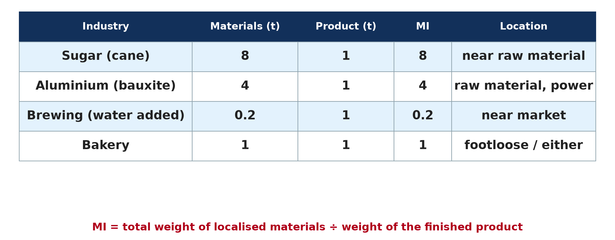
GEOGRAPHY — UPPER SIXTH ARTS
I. MATERIAL INDEX
Activity 1
Material index of several industries.
2026 / 2027
DGCAST GAROUA — GEOGRAPHY DEPARTMENT
Mr KAMDEM E. | 14
Notes:
Without the projector: calculate MI for each.

Slide 15
GEOGRAPHY — UPPER SIXTH ARTS
I. MATERIAL INDEX
Activity 1: Question
Why is brewing market-oriented?
2026 / 2027
DGCAST GAROUA — GEOGRAPHY DEPARTMENT
Mr KAMDEM E. | 15

Slide 16
GEOGRAPHY — UPPER SIXTH ARTS
I. MATERIAL INDEX
Answer
MI = 0.2: water is added at the market, so the product gains weight.
2026 / 2027
DGCAST GAROUA — GEOGRAPHY DEPARTMENT
Mr KAMDEM E. | 16

Slide 17

GEOGRAPHY — UPPER SIXTH ARTS
II. TON-KILOMETRES
Activity 2
A location triangle.
2026 / 2027
DGCAST GAROUA — GEOGRAPHY DEPARTMENT
Mr KAMDEM E. | 17
Notes:
Without the projector: compare several sites.

Slide 18
GEOGRAPHY — UPPER SIXTH ARTS
II. TON-KILOMETRES
Activity 2: Question
A site is 20 km from 2 t of ore and 10 km from a market for 1 t of product. Find the ton-km.
2026 / 2027
DGCAST GAROUA — GEOGRAPHY DEPARTMENT
Mr KAMDEM E. | 18

Slide 19
GEOGRAPHY — UPPER SIXTH ARTS
II. TON-KILOMETRES
Answer
2 × 20 + 1 × 10 = 50 ton-km.
2026 / 2027
DGCAST GAROUA — GEOGRAPHY DEPARTMENT
Mr KAMDEM E. | 19

Slide 20
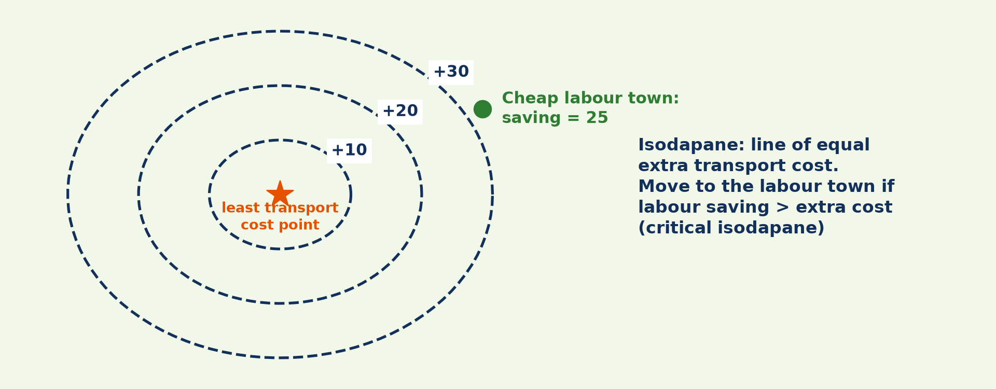
GEOGRAPHY — UPPER SIXTH ARTS
III. ISODAPANES
Activity 3
Isodapanes.
2026 / 2027
DGCAST GAROUA — GEOGRAPHY DEPARTMENT
Mr KAMDEM E. | 20
Notes:
Without the projector: discuss the critical isodapane.

Slide 21
GEOGRAPHY — UPPER SIXTH ARTS
III. ISODAPANES
Activity 3: Question
The labour town saves 25 per tonne and lies between the +20 and +30 isodapanes. Should the firm move?
2026 / 2027
DGCAST GAROUA — GEOGRAPHY DEPARTMENT
Mr KAMDEM E. | 21

Slide 22
GEOGRAPHY — UPPER SIXTH ARTS
III. ISODAPANES
Answer
Only if the extra cost there is below 25; between +20 and +30 it depends on the exact position.
2026 / 2027
DGCAST GAROUA — GEOGRAPHY DEPARTMENT
Mr KAMDEM E. | 22

Slide 23

GEOGRAPHY — UPPER SIXTH ARTS
IV. APPLICATION
Activity 4
A bauxite mine.
2026 / 2027
DGCAST GAROUA — GEOGRAPHY DEPARTMENT
Mr KAMDEM E. | 23
Notes:
Without the projector: discuss Minim-Martap.

Slide 24
GEOGRAPHY — UPPER SIXTH ARTS
IV. APPLICATION
Activity 4: Question
Aluminium: 4 t of bauxite give 1 t of metal. Where should the refinery be?
2026 / 2027
DGCAST GAROUA — GEOGRAPHY DEPARTMENT
Mr KAMDEM E. | 24

Slide 25
GEOGRAPHY — UPPER SIXTH ARTS
IV. APPLICATION
Answer
MI = 4, so near the bauxite (if power is available).
2026 / 2027
DGCAST GAROUA — GEOGRAPHY DEPARTMENT
Mr KAMDEM E. | 25

Slide 26

GEOGRAPHY — UPPER SIXTH ARTS
V. INTERPRETATION
Activity 5
Location factors.
2026 / 2027
DGCAST GAROUA — GEOGRAPHY DEPARTMENT
Mr KAMDEM E. | 26
Notes:
Without the projector: discuss limits.

Slide 27
GEOGRAPHY — UPPER SIXTH ARTS
V. INTERPRETATION
Activity 5: Question
Why may real factories not follow the calculation?
2026 / 2027
DGCAST GAROUA — GEOGRAPHY DEPARTMENT
Mr KAMDEM E. | 27

Slide 28
GEOGRAPHY — UPPER SIXTH ARTS
V. INTERPRETATION
Answer
Power, labour, government and markets also matter.
2026 / 2027
DGCAST GAROUA — GEOGRAPHY DEPARTMENT
Mr KAMDEM E. | 28

Slide 29
GEOGRAPHY — UPPER SIXTH ARTS
BOARD SUMMARY
Material Index, Location Triangles and Isodapanes
Topic: Theories of Industrial Location
Sub-topic: Theories of Industrial Location
Practical Work 3: Material Index, Location Triangles and Isodapanes
2026 / 2027
DGCAST GAROUA — GEOGRAPHY DEPARTMENT
Mr KAMDEM E. | 29
Notes:
Learners copy the board summary now. Give them enough time for each slide.

Slide 30
GEOGRAPHY — UPPER SIXTH ARTS
BOARD SUMMARY
I. Definitions
Ton-kilometre: It is the cost unit of moving one tonne over one kilometre.
Critical isodapane: It is the isodapane where extra transport cost equals labour savings.
2026 / 2027
DGCAST GAROUA — GEOGRAPHY DEPARTMENT
Mr KAMDEM E. | 30

Slide 31
GEOGRAPHY — UPPER SIXTH ARTS
BOARD SUMMARY
II. Method (1/2)
A. Material index: MI = total weight of localised materials ÷ weight of product. MI > 1 gives a material location, and MI < 1 a market location.
B. Location triangle: Calculate ton-kilometres from each site to materials and market. The site with the lowest total is the least-cost point.
2026 / 2027
DGCAST GAROUA — GEOGRAPHY DEPARTMENT
Mr KAMDEM E. | 31

Slide 32
GEOGRAPHY — UPPER SIXTH ARTS
BOARD SUMMARY
II. Method (2/2)
C. Isodapanes: Draw lines of equal extra cost around the least-cost point. Compare with the labour saving to find the critical isodapane.
2026 / 2027
DGCAST GAROUA — GEOGRAPHY DEPARTMENT
Mr KAMDEM E. | 32

Slide 33
GEOGRAPHY — UPPER SIXTH ARTS
BOARD SUMMARY
III. Interpretation
A. Results: Weight-losing industries locate near materials, and weight-gaining ones near markets. Cheap labour inside the critical isodapane attracts the firm.
B. Limits: Real costs are not linear and other factors intervene. The method gives only a guide.
2026 / 2027
DGCAST GAROUA — GEOGRAPHY DEPARTMENT
Mr KAMDEM E. | 33

Slide 34
GEOGRAPHY — UPPER SIXTH ARTS
FORMATIVE EVALUATION
Formative Evaluation 1
Cement uses 1.6 t limestone and 0.2 t gypsum per tonne. Find MI and the location.
2026 / 2027
DGCAST GAROUA — GEOGRAPHY DEPARTMENT
Mr KAMDEM E. | 34

Slide 35
GEOGRAPHY — UPPER SIXTH ARTS
FORMATIVE EVALUATION
Expected Answer
MI = 1.8, near the limestone.
2026 / 2027
DGCAST GAROUA — GEOGRAPHY DEPARTMENT
Mr KAMDEM E. | 35

Slide 36
GEOGRAPHY — UPPER SIXTH ARTS
FORMATIVE EVALUATION
Formative Evaluation 2
When does a firm move to a cheap-labour site?
2026 / 2027
DGCAST GAROUA — GEOGRAPHY DEPARTMENT
Mr KAMDEM E. | 36

Slide 37
GEOGRAPHY — UPPER SIXTH ARTS
FORMATIVE EVALUATION
Expected Answer
When the site is inside the critical isodapane (savings > extra costs).
2026 / 2027
DGCAST GAROUA — GEOGRAPHY DEPARTMENT
Mr KAMDEM E. | 37

Slide 38
GEOGRAPHY — UPPER SIXTH ARTS
REMEDIATION
Remediation
Fill in the blanks:
MI = materials ÷ ______.
Moving 1 t over 1 km is one ______.
Savings equal to extra cost define the ______ isodapane.
2026 / 2027
DGCAST GAROUA — GEOGRAPHY DEPARTMENT
Mr KAMDEM E. | 38
Notes:
Answers: 1. product 2. ton-kilometre 3. critical

Slide 39
GEOGRAPHY — UPPER SIXTH ARTS
HOMEWORK
Homework
Calculate ton-kilometres for three sites and choose the least-cost site.
This prepares Lesson 24: Other Theories of Industrial Location.
2026 / 2027
DGCAST GAROUA — GEOGRAPHY DEPARTMENT
Mr KAMDEM E. | 39
Notes:
This homework prepares the next lesson.

Slide 40
GEOGRAPHY — UPPER SIXTH ARTS
BILINGUAL GAME
Bilingual Game (Jeu Bilingue)
English | Français
Calculation | Le calcul
Site | Le site
Limestone | Le calcaire
Cement | Le ciment
Saving | L'économie
Isodapane | L'isodapane
2026 / 2027
DGCAST GAROUA — GEOGRAPHY DEPARTMENT
Mr KAMDEM E. | 40
Notes:
Say the English word; learners give the French word, then the reverse.

Slide 41
GEOGRAPHY — UPPER SIXTH ARTS
LOGBOOK
Official Logbook (1/2)
Module / Topic | Theories of Industrial Location
Lesson Title | Practical Work 3: Material Index, Location Triangles and Isodapanes
Expected Learning Outcomes | Calculate the material index. Find the least transport cost point in a triangle. Interpret isodapanes for a labour location.
Competence | Learners are able to calculate the material index and use isodapanes.
2026 / 2027
DGCAST GAROUA — GEOGRAPHY DEPARTMENT
Mr KAMDEM E. | 41

Slide 42
GEOGRAPHY — UPPER SIXTH ARTS
LOGBOOK
Official Logbook (2/2)
Matter Taught | I. Definitions: Ton-kilometre, Critical isodapane; II. Method: Material index, Location triangle, Isodapanes; III. Interpretation: Results, Limits.
Evaluation | Formative evaluation (3 questions) and remediation exercise.
Homework | Calculate ton-kilometres for three sites and choose the least-cost site.
Enrolment / Present / Absent | ____ / ____ / ____
Achievement | To be completed by the teacher after the lesson.
2026 / 2027
DGCAST GAROUA — GEOGRAPHY DEPARTMENT
Mr KAMDEM E. | 42

Slide 43
GEOGRAPHY — UPPER SIXTH ARTS
TEACHER'S NOTE
Teacher's Note
Timing: Set-up, recall 8 min | Situation 8 min | 5 activities 30 min | Board summary (copying) 30 min | Evaluation, remediation 10 min | Homework, logbook 9 min | Spare 5 min
2026 / 2027
DGCAST GAROUA — GEOGRAPHY DEPARTMENT
Mr KAMDEM E. | 43

Slide 44
GEOGRAPHY — UPPER SIXTH ARTS
REFERENCES
References
National Geography Syllabus, Sixth Forms (Lower & Upper Sixth), MINESEC/IGE/IP-SS, August 2019 — Module 6 (Economic Geography).
Photo, Activity 4: “Bauxite mine near Itea, Greece” by Jason-Morrison, CC BY-NC 2.0, via Flickr (https://www.flickr.com/photos/8998833@N07/929316608)
Diagrams and animations: drawn for this lesson (DGCAST Geography Department).
2026 / 2027
DGCAST GAROUA — GEOGRAPHY DEPARTMENT
Mr KAMDEM E. | 44

